Slide 1
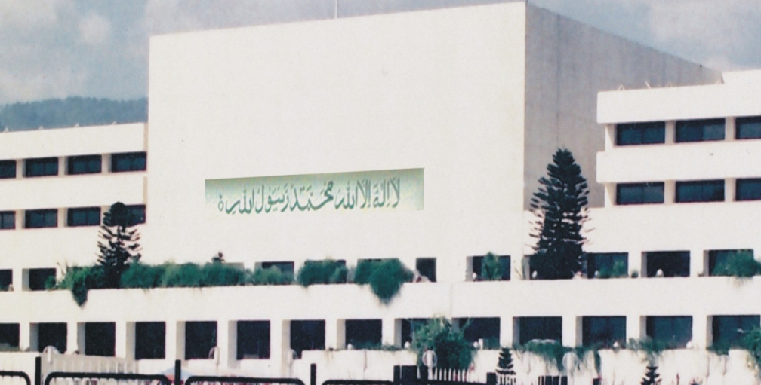
Democracy and Democracy in Pakistan
Dr Syed Hussain Shaheed Soherwordi
University of Peshawar

Slide 2
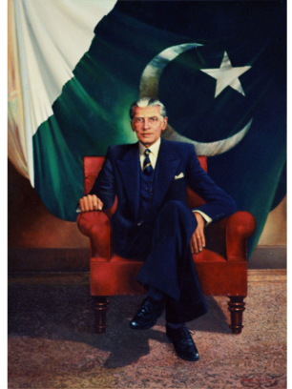
“It is my belief that our salvation lies in following the golden rules of conduct set for us by our great law-giver--- the Prophet (peace be upon him) of Islam. Let us lay the foundation of our democracy on the basis of truly Islamic deals and principles. Our Almighty has taught us that our decisions in the affairs of the state shall be guided by discussions and consultations”
Speech by Jinnah at Shahi Darbar , Sibi , 14 February 1948.

Slide 3
Lecture Plan
Why Classify Political Systems?
Aristotle’s Classification
Aristotle’s Ideal Type
The 20th Century and the ‘Three Worlds’ Typology
The Fall of the Three Worlds Typology
Contemporary Regime Classification
Strong and Weak aspects of Pakistan’s Parliament
Theory and Practice
Recommendations

Slide 4
Why Classify Political Systems?
It is essential to boosting our understanding of politics and governments
To facilitate evaluation of our political systems (the rise and fall of dictators and democracy)

Slide 5
Aristotle’s Classification
Democracy
Oligarchy
Tyranny
Aristotle formulated his classification by
asking two questions:
who rules?
who benefits from the rule?

Slide 6
Aristotle’s Six Forms of Government
Tyranny | Oligarchy | Democracy
Monarchy | Aristocracy | Polity

Slide 7
Aristotle’s Ideal Type
Tyranny was the worst form of government possible – as it reduced citizens to slaves.
Monarchy and Aristocracy were impractical systems – as they were based on a willingness to put the interests of the community before the rulers own.
Polity – rule by the many for the interests of all, was accepted by Aristotle as being the most practicable form of systems
The ideal type of political system was one which had elements of both democracy and aristocracy – mixed constitution which left government in the hands of the middle classes.

Slide 8
18th Century and the Development of Constitutional Systems
Three specific political systems – ensure that
Aristotle’s classification was outdated:
Constitutional republicanism established in the USA via the War of Independence (1775-1783)
Democratic radicalism unleashed in France via the French Revolution of 1789
Parliamentary government which emerged in the UK

Slide 9
The 20th Century and the ‘Three Worlds’ Typology
During the 20th century distinctions
have been sharpened further.
Collapse of political systems post-WW2 led to
The ‘three’ worlds typology in the 1960s. The
‘three worlds’ classification of political systems
dominated with systems seen as either:
1. a capitalist ‘first world’
2. a communist ‘second world’
3. a developing ‘third world’

Slide 10
The 20th Century and the ‘Three Worlds’ Typology (cont’d)
The three-world classification had economic,
ideological, political and strategic
dimensions:
Economic
1. Industrialised regimes were ‘first’ in economic terms
2. Communist regimes were capable only of satisfying their population’s most basic needs
3. Less developed countries of the third world – were third in the sense that they were economically dependent

Slide 11
The 20th Century and the ‘Three Worlds’ Typology (cont’d)
Ideological
First world vs. second world
Capitalism vs. Communism

Slide 12
The Fall of the ‘Three’ Worlds Typology
The 1970s and the emergence of the ‘fourth’ world
Disintegration of the Soviet Union
Fukuyama – ‘the end of history’ (1989) and the triumph of western liberal democracy

Slide 13
Regimes of the Modern World
Criteria for a new typology
Who rules?
How is compliance assured?
Is government centralised or fragmented?
How is power acquired?
What is the balance between parliament and individual and its good governance?
How is economic life organised?
Is the regime and parliament stable?

Slide 14
Contemporary Regime Classification
It is by virtue of the systems approaches that
five regime types can finally be delineated,
regime types which are fit for contemporary
world we live in:
Western Polyarchies
Post-Communist Regimes
East Asia Regimes
Islamic Regimes
Military Regimes

Slide 15
East Asian Regimes
In the second half of the 20th century the
world’s economic focus has shifted from the
West to the East.
Eastern Polyarchies:
These systems are focussed more around economic than political goals
This is broad support for ‘strong’ government and state
Support and heavy identification with the leader – Confucian stress on loyalty

Slide 16
Islamic Regimes
Two ways of coming into being:
1. those states where the existing political order has been overtly challenged – Iranian revolution of 1979. Similar stories in Sudan and Pakistan
2. cases where regimes have been deliberately constructed along Islamic lines – e.g. Saudi Arabia which has been Islamic since its inception in 1932.

Slide 17
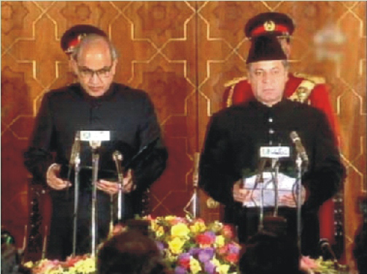
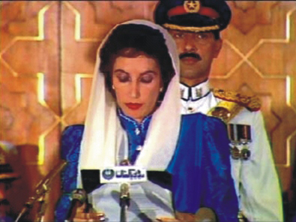
PAKISTAN
To Strengthen Democracy & Democratic Institutions
Parliamentary Strengthening & Parliamentary Performance

Slide 18
Two Types of Government in Pakistan
Political
  1947-58 (Democracy)
  1870-77 (The Bhutto Years)
  1988-99 (Return to Democracy)
  2008-till present (Re-return to Democracy)
Military
1958-69 (Military Dictatorship, Basic Democracy)
1977-88 (Military rule, Islamic Democracy)
1999-2008 (Military rule, Real Democracy)

Slide 19
Good Governance and the Legislature
In Pakistan, Most of the public policy decisions are taken by unrepresentative institutions
Assertive role of parliament, when the defense budget of 2008 was presented in the National Assembly and Senate. Till 1958, detailed defense budget was presented in the central legislature.

Slide 20
According to the rules of business 1973, PM is the ultimate authority to approve or amend any policy framework. Ministers are responsible for their respective policies of their ministries.
However, from 1972 till 2002, there had been no labor policy and at the present there is no education policy at all.
Out of 45, only 34 ministries have got their policy formulation mandate.

Slide 21
Strongest Aspects
Composition of the National Assembly is representative of Women: (76 or 22% women)
Autonomy of the Parliament
Satisfactory Parliamentary Procedures for Full and Open Debate on Legislation in the Parliament
Ample freedom to journalists in reporting on the Parliament & its members
Observance of agreed Code of Conduct by members
Effectiveness in inter-parliamentary cooperation

Slide 22
Weakest Aspects
Inability to scrutinize executive appointments
Weak process to consult various interest groups over legislation
Very little Opportunity to citizens’ direct involvement in legislation through citizens’ initiatives
Transparency of procedures to prevent conflict of interest
Oversight of funding to candidates & parties
Weak or non-existent parliamentary oversight of deployment of country’s armed forces abroad
Assembly’s Involvement in Foreign Policy

Slide 23
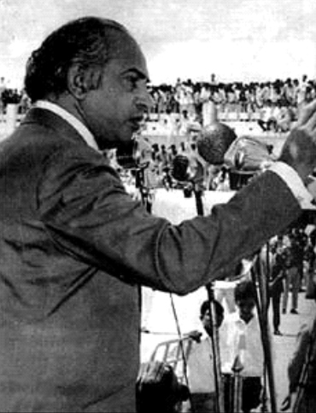
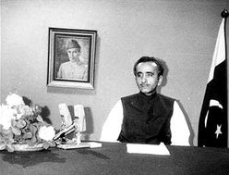
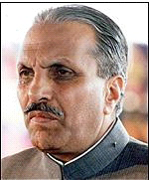
Parliament in Theory
Sovereign Parliament
Parliament- A supreme institution
Parliament- A reflection of public opinion
Parliament- A representation of the people

Slide 24
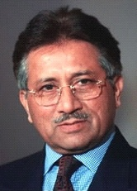
Parliament in Practice
Kerry-Lugar Bill is accepted but not approved by the Parliament. Its withdrawn after speeches on the floor
Judiciary is restored by the Lawyers movement and by the long march of a political party and not by the Parliament
People reject the federal budget and
RGST
Parliament endorses the dictators

Slide 25
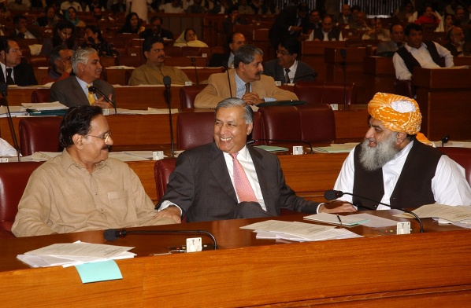
Pakistan’s class-based society: Is Parliament representing the labor, middles and poor class or industrialist, rich and duke class?
Taxes on salaried class and industries’ owners and not on agriculture????
Opposition for the sake of opposition or constructive opposition??

Slide 26
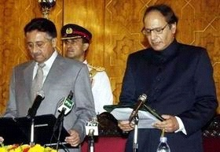
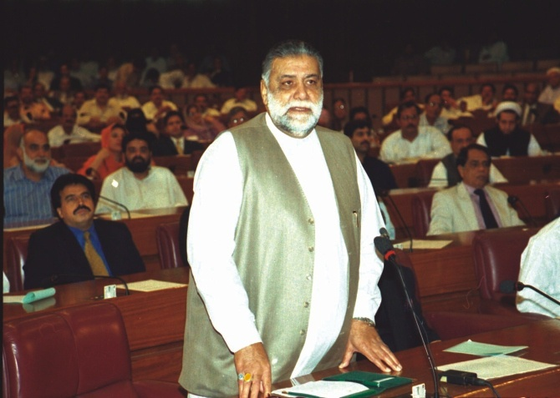
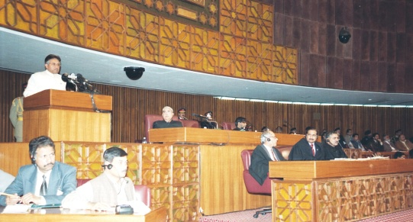
Usually, opposition and time-servers in the parliament support rise of a dictator in the country
Collision of institutions initiated by the parliament results in lack of its attention towards good governance (judiciary vs. Parliament, President), and eventually break up of political process

Slide 27
Recommendations
Election Spending Limits be strictly enforced
Make Parliament’s role effective in Budget Process
Parliament should scrutinize key appointments
Provide adequate and non-partisan research service
Institute system of public consultation
Attract young people to work in the Parliament

Slide 28
Involve citizens in legislative process
Institute a system to check members’ conflict of interest
Adequate oversight on funding to parties & candidates
Institute a system to monitor levels of public confidence
Parliamentary Committees on Foreign Affairs be more pro-active

